Slide 1
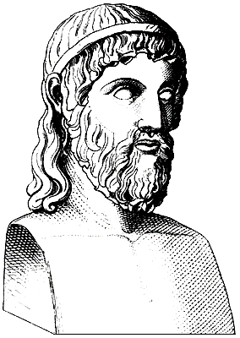
Pythagoras’ Theorem
Topic: Pythagoras
EQ: what is special about right-angled triangles?
Pythagoras discovered that for any right angled triangle, the area of the square drawn on the hypotenuse (the longest side, opposite the right angle) is equal to the sum of the areas of the squares drawn on the other two sides.

Slide 2
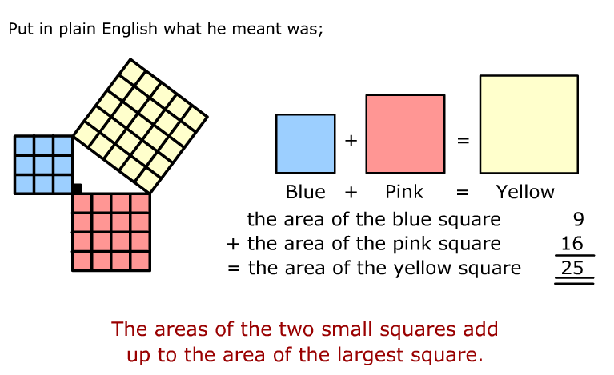
Topic: Pythagoras
EQ: what is special about right-angled triangles?

Slide 3
Topic: Pythagoras
EQ: what is special about right-angled triangles?
Hypotenuse
c
a² + b² = c²
a
b

Slide 4
We can use Pythagoras’ theorem to work out the missing side of triangles…
Find the missing side, ‘x’
a² + b² = c²
c
8² + 6² = x²
a
x cm
64 + 36 = x²
100 = x²
8cm
x = √100
x = 10 cm
6cm
b

Slide 5
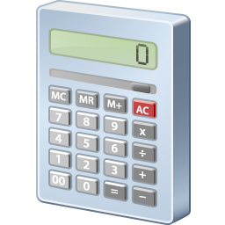
Find the missing side ‘x’
a² + b² = c²
17² + 4² = x²
c
17cm
x cm
289 + 16 = x²
305 = x²
a
x = √305
x = 17.5 cm (to 1 d.p.)
4cm
b

Slide 6
Find the missing side ‘x’
a² + b² = c²
12² + x² = 13²
c
a
144 + x² = 169
x² = 169 – 144
= 25
13cm
12cm
x = √25
x = 5 cm
x cm
b

Slide 7
Find the missing side ‘x’
a² + b² = c²
x² + 6² = 9²
c
a
x² + 36 = 81
x² = 81 – 36
= 45
9mm
x mm
x = √45
x = 6.7 mm (to 1 d.p.)
6mm
b

